Slide 1
Lab 6 – Integrated Systems Engineering Lab ENGR 1181 | Lab 6

Slide 2
Branches of Integrated Systems Engineering
Human Factors
Manufacturing
Operations Research

Slide 3
Operations Research in the Real World
Operations research utilizes mathematics, system modeling, and evaluating resources in order to inform decision-making processes
What are real world examples of Operations Research that we are familiar with?
Haiti Relief Efforts - Video
Notes:
https://www.youtube.com/watch?v=sC-Qrdguj9M&feature=youtu.be

Slide 4
Today's Learning Objectives
Explain the role of Operations Research in Integrated Systems Engineering.
Identify the branches of Integrated Systems Engineering which include human factors, manufacturing and operations research.
Develop floorplan layouts and process maps.
Justify process plan and floorplan layout decisions.
Construct a technical summary that reports on findings and recommendations for improving a process plan and floorplan layout.

Slide 5
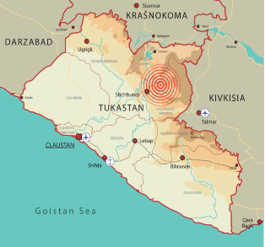
Background
An earthquake measuring 7.0 on the Richter Scale hit eastern and central Tukastan.
Substantial relief supplies are being delivered to Tukastan from over 80 international and national relief organizations.
The most critical challenges at this stage are the logistics for handling and organizing humanitarian relief supplies to quickly and efficiently deliver to hard to reach areas.

Slide 6
Lab Tasks
Tasks found in procedure are role specific:
Operations Managers will work with the Process Mappers to develop a flow chart of the steps required for unloading the cargo plane. They will determine total time it takes for completed tasks.
Layout Planners will work to develop a warehouse layout that organizes the relief supplies delivered by the cargo plane.
Objective: As employees of a supply chain company, you and your team will work together to develop an efficient process plan and warehouse layout that meets the needs of the humanitarian relief effort.

Slide 7
Lab Roles
3-4 people/team
Each team should consist of: 2 Layout Planners, 1 Process Mapper and/or 1 Operations Manager
Take a minute and decide your team roles.

Slide 8
Important Takeaways
The importance of operations research in real world applications
The role of process maps and layout plans in improving efficiency of work spaces
Consideration for the role of engineering in humanitarian relief efforts

Slide 9
Looking Ahead
Write the Lab 06 Executive Summary (Group Assignment)
Finish Process Maps and Layout Plans
Submit on Carmen
Read Lab 07 – Wind Turbine Procedure

